Slide 1

STARTING WITH KEY PERFORMANCE INDICATORS
TO A DATABASE SCHEMA FOR AN ONLINE SHOP
24.02.2020 | FINAL PROJECT | CIS-597 SPEC.TOP. DATA ENGINEERING |
MAX FRANKE, MARIAH BASTOS

Slide 2

Agenda
1
Initial situation in the company
2
Building a database - 6 steps to Business Intelligence
3
Definition of the KPI’s for an Online Shop
4
Database & SQL

Slide 3
Initial situation in the company
Before the project (without an Online Shop)
After the project (Aim of the Project)
1
Sales of car parts as a wholesaler to distributors
Global expansion of customer base
Many existing customers, acquisition of new customers is difficult
Target group-oriented product marketing
2
3
Distributors reduce the margin
Performance Measurement
Online Shopping
Entity-Relationship Diagram as a base, continuous improvement of the product range
Direct sales to end users

Slide 4
Building a relational model - 6 steps to Business Intelligence
1
How is a key figure system to be set up?
6
2
How do you visualize the data?
Which & how many key figures are important?
6 steps to Business Intelligence
5
3
At what point do you introduce the reports?
How often should you report?
4
Where does the data come from?
Source: Whitepaper: KPIs im E-Commerce [dotsource], 2018
Notes:
1- WHICH KPIS, HOW DO WE CONNECT THE DATABASE, HOW MANY DATABASES WE HAVE?
2- TRAFFIC, REVENUE, SALES?
3- WEEKLY, MONTHLY?
4- ERP SYSTEMS, GOOGLE ANALYTICS, ONLINE SYSTEMS?
5- AFTER TWO WEEKS, 1 MONTH?
6- POWER BI, TABLEAU, EXCEL?

Slide 5
6 perspectives of the performance measurement system– Balance Scorecard
1
How is a key figure system to be set up?
Financial Perspective
Frontend
Sales volume & revenue
Purchasing & logistic
Key earnings figures
Technical metrics
All key figures to evaluate the size & performance of the shop
Access numbers & dropout rates
Basic key figures
Internal process perspective
Sales per day, cost-sales ratio, number of returns, shopping cart, number of orders...
Incoming orders
Prices
Online-Marketing
Customer Perspective
Traffic
Conversion
Customer Communication
Customer base
Customer index, subscriptions etc.
Customer support
Notes:
1. Financial perspective:
Capturing the success of all perspectives
2. Acquisition cost (price per package), order receipt
3. Gross Margin, EBIT, DB
2. Frontend
Performance of the eCommerce system
Site availability, size, loading time
Visits, page impressions, cancellation rates
3. Internal
Tbd
4. Customers
Optimize customer satisfaction and increase returning customers
Customer index (=change in number of registered users)
Number & evaluation of support tickets, purchase & product ratings, returns management
5. Online marketing
Measurement & success assessment of online marketing activities
Visits, Unique Visitors, Page Views, Visiting Depth, Bounce Rate
Cost-per-conversion
Newsletter Click & Opening Rates, Number of Social Media Fans & Followers
6. Basic key figures

Slide 6
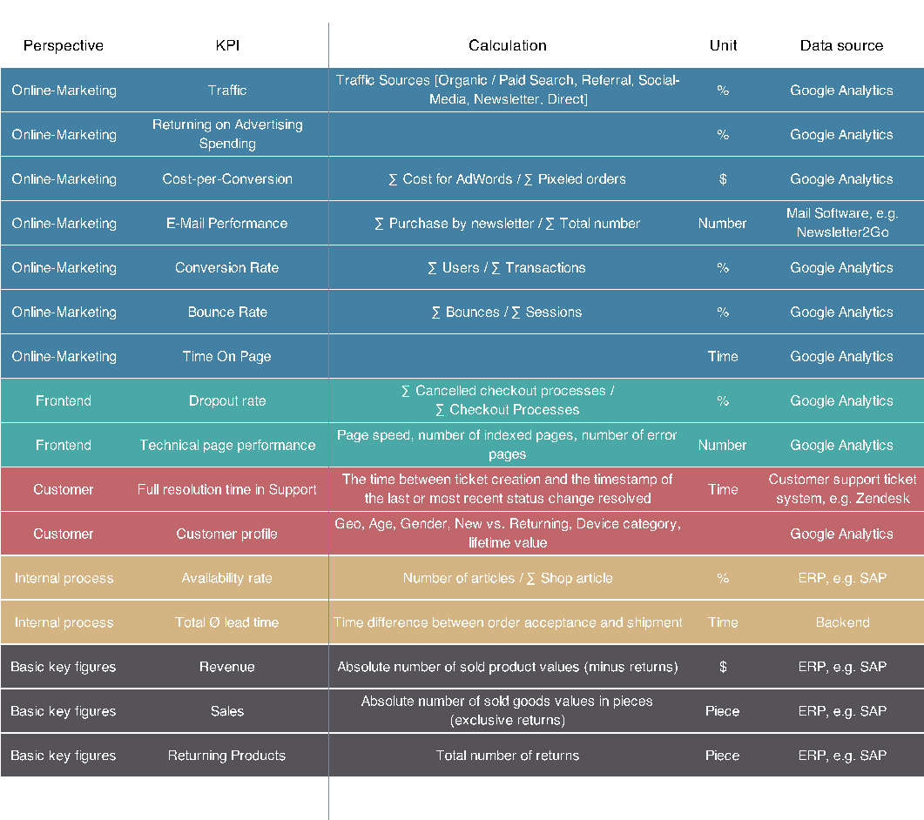
Definition of the KPI’s for an Online Shop

Slide 7
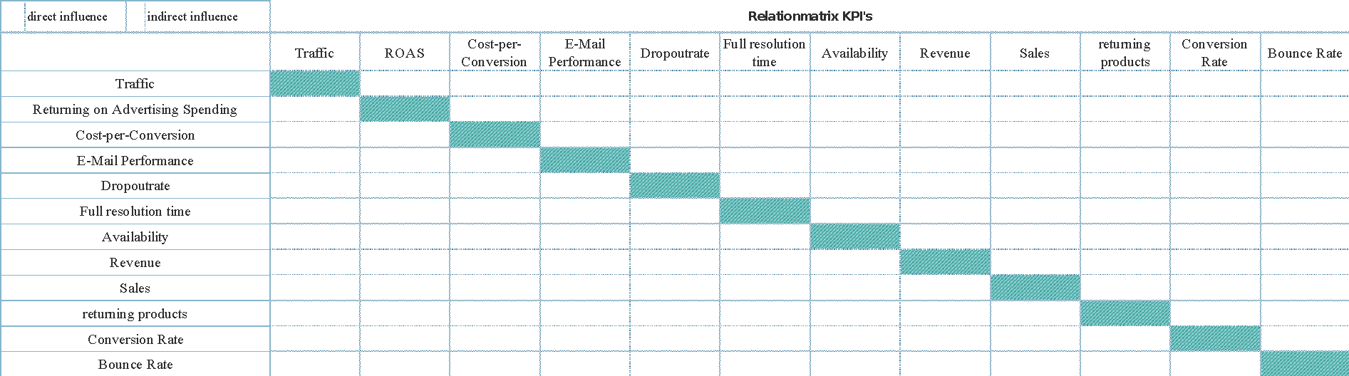

Slide 8
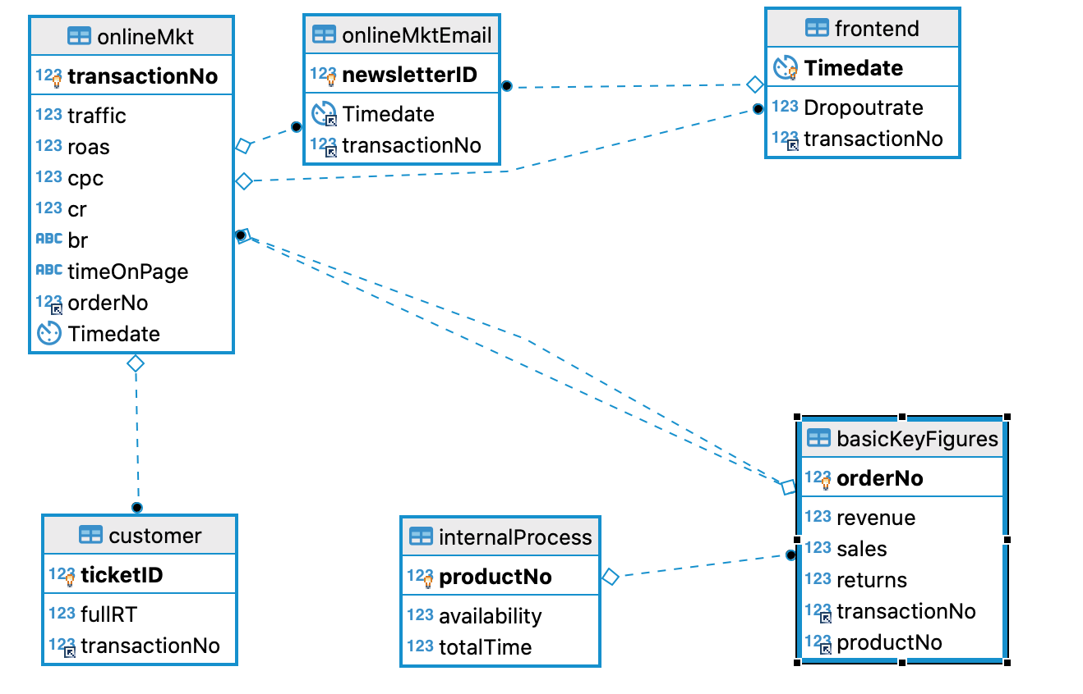
Database in DBeaver

Slide 9
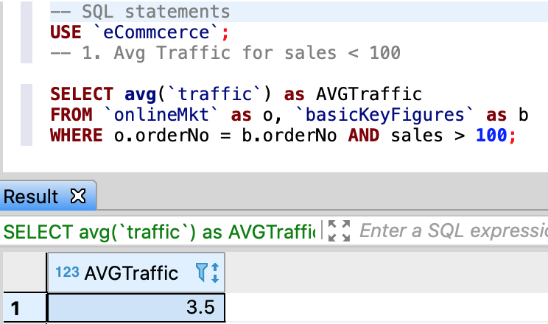
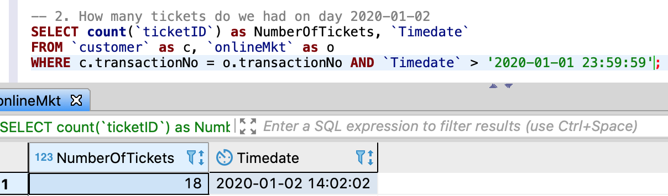
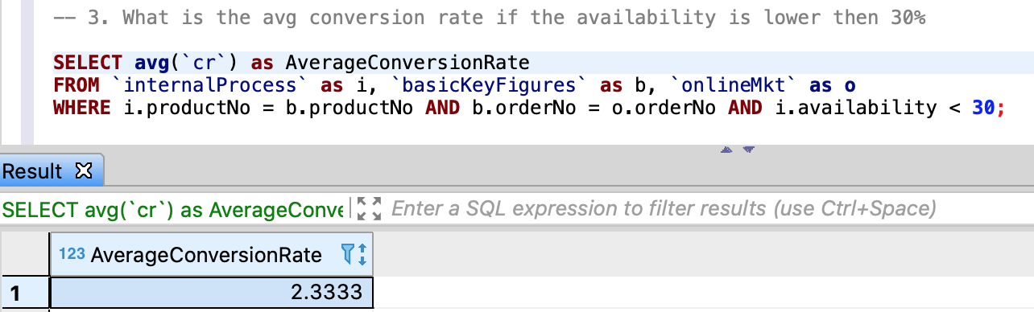
SQL statements

Slide 10
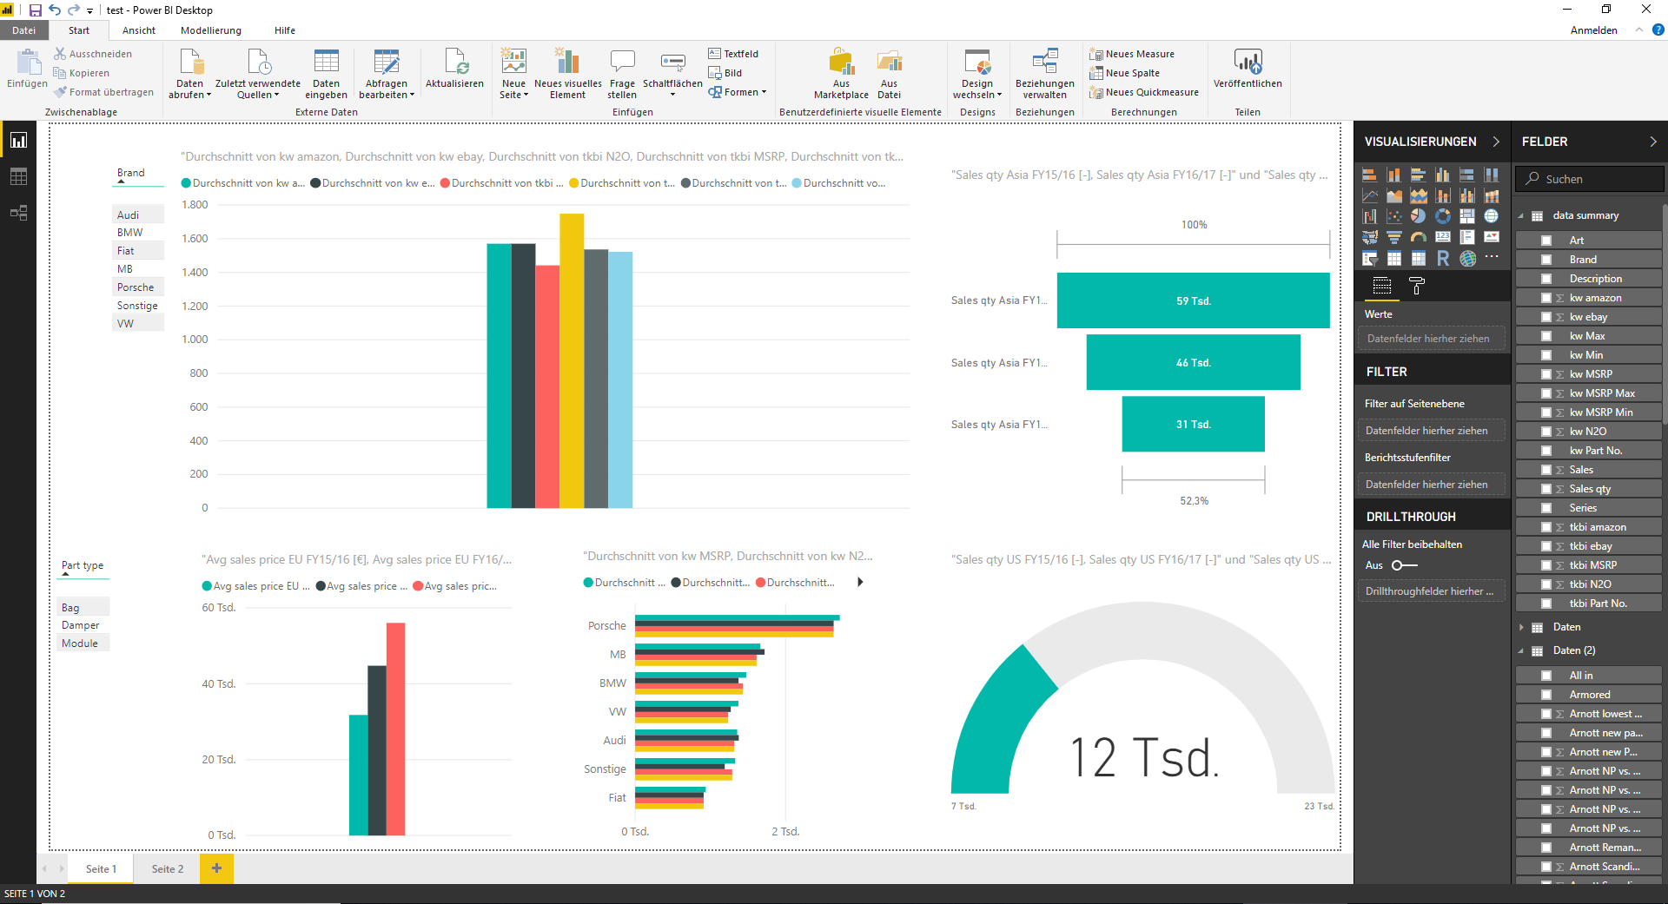





All data sources can also directly import into PowerBi
Mail Software
Customer Support Ticket

Slide 11
THANK YOU
Max Franke | Mariah Bastos

Slide 12







Literature – eCommerce Performance
Performance Marketing [I. Kamps, D. Schetter], 2018
Case Study: Social Data-Analyse [Bonduelle, talkwalker], 2018
Whitepaper: KPIs im E-Commerce [dotsource], 2018
Kennzahlenmodell zur Erfolgsbewertung des E-Commerce [C. Hienerth], 2007
Trend Studie 2018 [Trakken], 2018
Whitepaper: Search-Engine Advertising optimieren [dotsource], 2016
Google Analytics und Co [H. Haller, M. Hartwig], 2010

